Slide 1
Social Security: With You Through Life’s Journey…
Produced at U.S. taxpayer expense
Notes:
(2020 Universal PowerPoint)
Notes to speaker:
You may want to add the name of the organization or event (seminar, conference, workshop, etc.) and the date of the event to this slide by clicking Insert, then clicking Text Box, and typing in the details.
DO NOT remove the taxpayer expense disclaimer from this slide, as it is now required by law.
Be sure to thank the person who invited you to speak, thank the organization for making SSA a part of today’s event, and make a few introductory comments (such as how long you have worked at SSA, your job title, and why you feel Social Security is relevant to this event/organization).
BEGINNING OF SPEAKER’S FORMAL SCRIPT:
For more than 80 years, Social Security has helped secure today and tomorrow by providing benefits and financial protection for millions of people throughout their life’s journey.
Social Security touches the lives of every American, both directly and indirectly. As you consider the information that you are about to receive, I encourage you to think about all the ways Social Security has been linked to your life – and the lives of your loved ones.

Slide 3
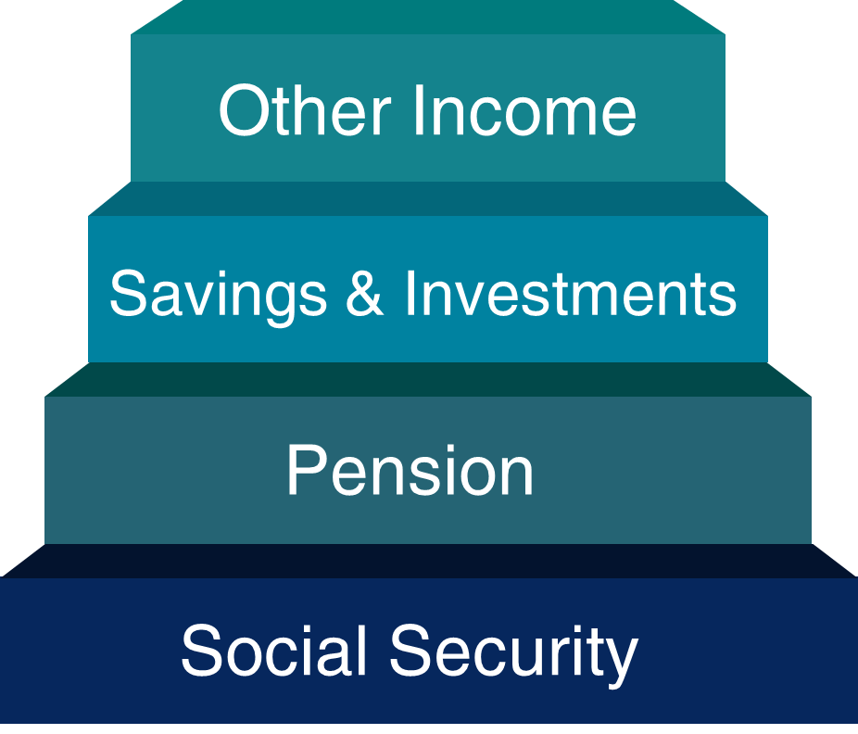
Three Legged Stool
Notes:
Social Security was never meant to be the only source of income for people when they retire.
It was always meant to be a base, a foundation, to be supplemented with savings, investments, 401ks, IRAs, etc.
For the average worker, Social Security replaces about 40 percent of their pre-retirement income.
Financial experts say you’ll need 70-80% of your pre-retirement income to live comfortably in retirement.
8/27/2020 - Speaker notes updated (JP)

Slide 4
What is FICA?
Stands for Federal Insurance Contributions Act
May show on paycheck as OASDI or Social Security
Federal payroll tax deducted from workers’ paychecks, matched by employer, and reported by employer to IRS
Total FICA tax = 15.3% of gross wages. You and your employer each pay 7.65%
6.2% for Social Security
1.45% for Medicare
FICA taxes help fund Social Security retirement, disability, survivor benefits and Medicare health insurance
Notes:
Most employers collect a federal payroll tax known as FICA, Federal Insurance Contributions Act, and report your earnings electronically.
This tax is collected from both employees and employers to fund Social Security and Medicare — federal programs that provide benefits for retirees, people with disabilities, and survivors.
The total FICA tax is 15.3 percent of your gross wages. You and your employer each pay 7.65 percent for FICA, 6.2 percent for Social Security and 1.45 percent for Medicare.
The current Social Security system works like this: when you work, you pay taxes into Social Security. The amount of taxes is based on your earnings, up to a certain amount. In 2022, that amount is $147,000.
You pay the Medicare tax on all your earnings. There is no taxable maximum.
The money you pay in taxes is not held in a personal account for you to use when you get benefits. We use your taxes to pay people who are getting benefits right now.
Source: 2022 COLA Fact Sheet: ssa.gov/news/press/factsheets/colafacts2022.pdf
Speaker notes and source updated: OISP/OEEMP 12/1/2021 (JP)

Slide 5
How Do You Qualify for Retirement Benefits?
By earning “credits” when you work and pay Social Security taxes
You need 40 credits (10 years of work) and you must be 62 or older
Each $1,640 in earnings gives you one credit
You can earn a maximum of 4 credits per year
Note: To earn 4 credits in 2023, you must earn at least $6,560.
ssa.gov/planners/credits.html
Notes:
Credits are the "building blocks" Social Security uses to find out whether you have the minimum amount of covered work to qualify for each type of Social Security benefit. If you stop working before you have enough credits to qualify for benefits, your credits will stay on your record. If you return to work later, you can add more credits so you can qualify.
No benefits can be paid if you do not have enough credits.
In 2023 you must earn $1,640 in covered earnings to get one Social Security or Medicare work credit and $6,560 to get the maximum four credits for the year.
When you work and pay Social Security taxes, you earn up to a maximum of four "credits" for each year.
During your lifetime, you will probably earn more credits than the minimum number you need to be eligible for benefits; however, these extra credits do not increase your benefit amount.
Your average earnings during your working years determine how much your monthly payment will be.
Source: ^OISP OAESP
Publications: ssa.gov/pubs/EN-05-10003.pdf (Update 2022) and ssa.gov/pubs/EN-05-10072.pdf (How You Earn Credits)
Slide and Speaker Notes updated: 11/8/2022 (JP/SY)

Slide 6
Year of Birth Full Retirement Age
1937 or earlier 65
1938 65 & 2 months
1939 65 & 4 months
1940 65 & 6 months
1941 65 & 8 months
1942 65 & 10 months
1943 – 1954 66
1955 66 & 2 months
1956 66 & 4 months
1957 66 & 6 months
1958 66 & 8 months
1959 66 & 10 months
1960 or later 67

Slide 7
What Is the Best Age to Start Receiving Social Security Retirement Benefits?
Note: This example assumes a benefit of $1,000 at a full retirement age of 66
Notes:
Choosing when to retire is an important and personal decision. Financial experts say you’ll need 70-80% of your pre-retirement income to have a comfortable retirement. You’ll want to choose a retirement age based on your circumstances, so you’ll have enough income when you need it.
As you can see on this chart, your monthly retirement benefit will be higher if you delay starting it. We calculate your basic Social Security benefit — the amount you would receive at your full retirement age — based on your lifetime earnings.
However, the actual amount you receive each month depends on when you start receiving benefits. You can start your retirement benefit at any point from age 62 up until age 70, and your benefit will be higher the longer you delay starting it. This adjustment is usually permanent: it sets the base for the benefits you’ll get for the rest of your life.
You may receive an annual cost-of-living adjustments and, depending on your work history, may receive higher benefits if you continue to work.
Let’s say your full retirement age is 66 and your monthly benefit starting at that age is $1,000. If you choose to start getting benefits at age 62, we’ll reduce your monthly benefit 25 percent to $750 to account for the longer period of time you receive benefits. If you choose to delay getting benefits until age 70, you would increase your monthly benefit to $1,320. This increase is from delayed retirement credits you earn for your decision to postpone receiving benefits past your full retirement age. The benefit at age 70 in this example is 32 percent more than you would receive each month if you had chosen to start getting benefits at full retirement age.
I encourage you to read our publication #05-10147 - When To Start Receiving Retirement Benefits @ ssa.gov/pubs/EN-05-10147.pdf
Slide notes updated with pub link 1/13/2021 (JP)

Slide 8
Working While Receiving Benefits
If you are | You can make up to | If you earn more, some benefits will be withheld
Under Full Retirement Age | $21,240/yr. | $1 for every $2
The Year Full Retirement Age is Reached | $56,520/yr. before month of full retirement age | $1 for every $3
Month of Full Retirement Age and Above | No Limit | No Limit
Retirement Earnings Test Calculator:
ssa.gov/OACT/COLA/RTeffect.html
Notes:
The first thing we recommend is that you visit ssa.gov/pubs and search for the publication entitled, How Work Affects Your Benefits. It explains the rules you must follow in order to avoid an overpayment, and it gives some great examples for different scenarios that could apply to your individual situation.
You can get Social Security retirement or survivors benefits and work at the same time. However, if you’re younger than full retirement age, and earn more than certain amounts, your monthly benefit remains the same but the total amount of benefits you receive for the year will be reduced. The amount that your annual benefits are reduced, however, isn’t truly lost. Your monthly benefit will be increased at your full retirement age to account for benefits withheld due to earlier earnings.
Note that spouses and survivors, who receive benefits because they have minor or disabled children in their care, don’t receive increased benefits at full retirement age if benefits were withheld because of work. I should also mention that different rules apply if you work outside the United States. Contact us if you’re working (or plan to work) outside the country.
But for most of you, here’s how this works. If you work, and are full retirement age or older, you may keep all of your benefits, no matter how much you earn.
If you’re younger than full retirement age, there is a limit to how much you can earn and still receive full Social Security benefits. If you’re younger than full retirement age, we must deduct $1 from your benefits for each $2 you earn above the annual limit. For 2023, that limit is $21,240.
If you reach full retirement age during 2023, we must deduct $1 from your benefits for each $3 you earn above $56,520 until the month you reach full retirement age.
Starting with the month you reach full retirement age, there is no limit on how much you can earn and still receive all of your Social Security benefits.
Note: If some of your retirement benefits are withheld because of your earnings, your benefits will be increased starting at your full retirement age to take into account those months in which benefits were withheld.
Source: OISP/OAESP
ssa.gov/pubs/EN-05-10069.pdf (How Work Affects Your Benefits)
Slide and Speaker Notes updated 11/8/2022 (JP/SY)

Slide 9
How Social Security Determines Your Benefit
Benefits are based on earnings
Step 1 - Your wages are adjusted for changes in wage levels over time
Step 2 - Find the monthly average of your 35 highest earnings years
Step 3 - Result is “average indexed monthly earnings”
ssa.gov/OACT/COLA/Benefits.html
Notes:
Credits are based on your total wages and self-employment income during the year, no matter when you did the actual work. You might work all year to earn four credits, or you might earn enough for all four in a much shorter length of time.
We are looking for the highest 35 years during a worker's lifetime of earnings, regardless of when earned.
Using this formula means that a worker who qualifies for a retirement benefit with just 10 years of work would have a lower benefit payment than someone who worked longer. That’s because we are looking at the highest 35 years of earnings. In this example, there would be 25 years with zero earnings.
Slide updated 9/1/2020 (JP)

Slide 10
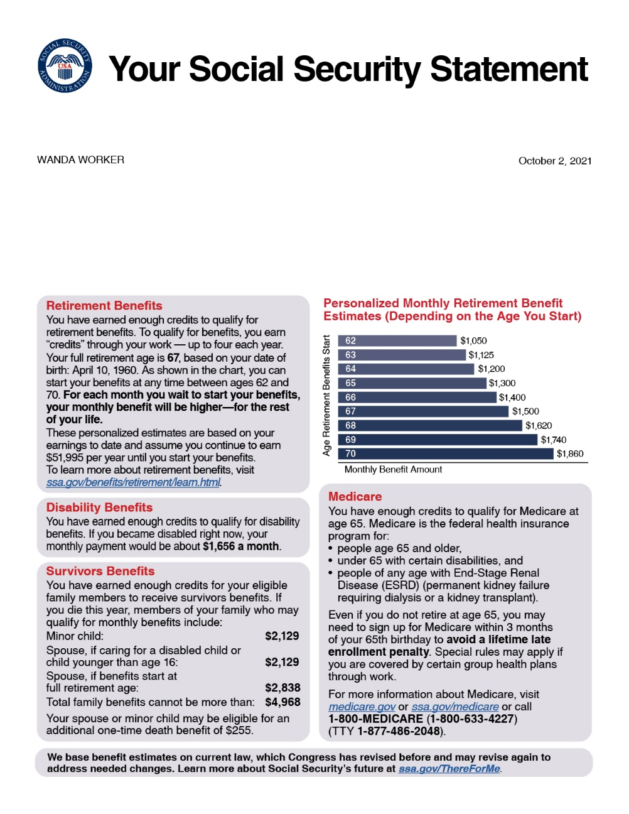
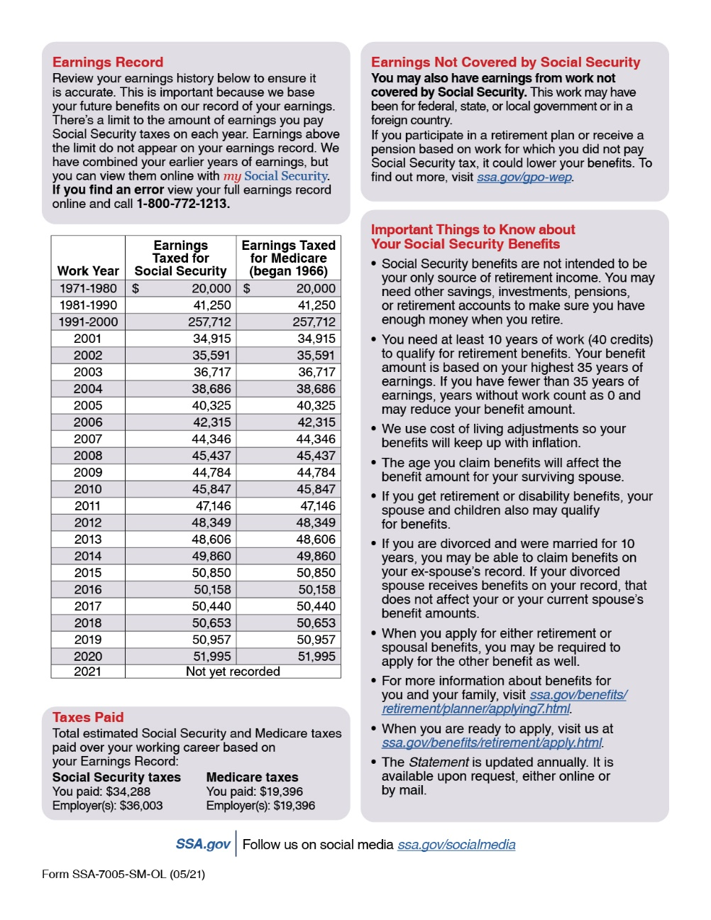
Social Securiaaty Statement
Notes:
10/6/2021 – slide updated (JP)

Slide 11
Retirement Calculator
Gives estimates based on your actual Social Security earnings record
You can use the Retirement Calculator if:
You have enough Social Security credits at this time to qualify for benefits and
You are not:
Currently receiving benefits on your own Social Security record;
Waiting for a decision about your application for benefits or Medicare;
Age 62 or older and receiving benefits on another Social Security record; or
Eligible for a Pension Based on Work Not Covered By Social Security.
Notes:
You can use the online Retirement Calculator at ssa.gov/benefits/retirement/estimator.html to get immediate and personalized benefit estimates to help you plan for your retirement.
It’s a convenient, secure and quick financial planning tool.
The Retirement Calculator, is an interactive tool that allows you to create “what if” scenarios.
You can, for example, change your “stop work” dates or “expected future earnings” to create and compare different retirement options.
10/21/2021 – slide updated (JP)

Slide 12
my Social Security
ssa.gov/myaccount
Notes:
my Social Security is a convenient and secure suite of services designed to put you in control of your personal Social Security information, as well as help you manage your benefits when you start receiving them. Your account gives you the information you need at your convenience - all without calling or visiting a local office.
You can only open a my Social Security account for yourself. You cannot open an account for another person, even if you have his or her written consent. You may be unable to open a my Social Security account if you:
• Blocked electronic access to your personal Social Security information; • Recently moved or changed your name; or • Placed a freeze on your credit report.
Your online my Social Security account provides a variety of information to help you and your family.
Speaker notes updated (DRB) 6/8/2022 (JP/AJ)

Slide 13
my Social Security
Get estimates based on your actual Social Security earnings record and for different ages when you want your benefits to start.
Estimates are available if:
You have enough Social Security credits at this time to qualify for benefits and
You are not:
Currently receiving benefits on your own Social Security record;
Waiting for a decision about your application for benefits or Medicare;
Age 62 or older and receiving benefits on another Social Security record; or
Eligible for a Pension Based on Work Not Covered By Social Security.
Notes:
3/7/2022 – slide updated (DRB)

Slide 14
Benefits for a Spouse
Maximum benefit = 50% of worker’s unreduced benefit
Reduction for early retirement
If spouse’s own benefit is less than 50% of the worker’s, they will be combined to equal to 50% of the worker’s
Does not reduce payment to the worker
Benefit is unreduced if spouse is caring for worker’s child younger than age 16 or disabled
Spouse benefits are not payable until worker collects
ssa.gov/planners/retire/yourspouse.html
Notes:
A spouse who has not worked or who has low earnings may be entitled to as much as one-half of the retired worker’s full benefit.
If you are eligible for both your own retirement benefits and for benefits as a spouse, we always pay your own benefits first. If your benefits as a spouse are higher than your retirement benefits, you will get a combination of benefits equaling the higher spouse benefit.
If a spouse wants to get Social Security retirement benefits before they reach full retirement age, the amount of the benefit is reduced. The amount of reduction depends on when the person reaches full retirement age.
The benefit is unreduced if the claiming spouse is caring for a child who is under the age of 16 or who is disabled.
The benefit is only payable if the claiming spouse’s own unreduced benefit rate, based on their earnings history, is less than 50% of the worker’s unreduced benefit rate. The claiming spouse must first file for their own benefit, based on their earnings history, which is subtracted from the full spousal benefit.
Slide updated 9/2/2020 (JP)

Slide 15
Benefits for Divorced Spouses
You may receive benefits on your former spouse's record (even if he or she has remarried) if:
Marriage lasted at least 10 years
You are unmarried
You are age 62 or older
Your ex-spouse is at least 62 and eligible for Social Security retirement or disability benefits, even if not collecting
Benefit you would receive based on your own work is less than benefit you would receive based on ex-spouse’s work
ssa.gov/planners/retire/yourdivspouse.html
Notes:
Your benefit as a divorced spouse is equal to one-half of your ex-spouse's full retirement amount (or disability benefit) if you start receiving benefits at your full retirement age. The benefits do not include any delayed retirement credits your ex-spouse may receive.
If you remarry, you generally cannot collect benefits on your former spouse's record unless your later marriage ends (whether by death, divorce or annulment).
If your ex-spouse has not applied for retirement benefits, but can qualify for them, you may receive benefits on his or her record if you have been divorced for at least two years.
If you are eligible for retirement benefits on your own record and divorced spouse’s benefits, we will pay the retirement benefit first. If the benefit on your ex-spouse’s record is higher, you will get an additional amount on your ex-spouse’s record so that the combination of benefits equals that higher amount.

Slide 16
Survivor Benefits
Child | May receive benefits if unmarried and younger than age 18, or between ages 18 and 19 and a full-time student (no higher than grade 12)
Disabled Child | May receive benefits after age 18 if unmarried and disabled before age 22
Widow/er or Divorced Widow/er (Remarriage after age 60 will not affect benefits) | May receive full benefits at full retirement age or reduced benefits: as early as age 60 as early as 50, if disabled at any age if caring for child younger than 16 or disabled
ssa.gov/planners/survivors
Notes:
Let’s take a look at how people become eligible for Social Security survivor benefits.
A child may receive benefits on a deceased parent’s record if he or she is not married and is under age 18, or between ages 18 and 19 and a full-time student (no higher than grade 12).
A disabled child may receive benefits beyond age 18 if he or she is not married and was disabled before age 22.
A widow or widower or divorced widow/widower may receive full benefits at full retirement age – or reduced benefits at age 60 – or as early as age 50 if disabled – or at any age if caring for child under 16 or a disabled child.
The length of marriage requirement for a widow or widower to be eligible for benefits is 9 months, and for a surviving divorced spouse it is 10 years. There are exceptions to the duration of marriage requirements.
Generally, you cannot get widow or widower benefits if you remarry before age 60. But remarriage after age 60 (or age 50 if you are disabled) will not prevent you from getting benefit payments based on your former spouse’s work. Also, at age 62 or older, you may get benefits based on your new spouse’s work, if those benefits would be higher.
Slide updated 12/1/2021 OAESP (JP)

Slide 17
Survivor Benefits
When you pass away, your surviving spouse may:
At full retirement age, receive 100% of deceased worker's unreduced benefit; or,
At age 60, receive 71.5% of your full benefit and increases each month you wait up to 100% if you start at full retirement age; or
Claim survivor benefits at any age between 60 and full retirement age.
Notes:
Next, let’s talk about how survivor benefits are calculated.
Your surviving spouse can claim survivor’s benefits once they reach age 60. If they start receiving survivors benefits at age 60, they will get 71.5% of your basic benefit amount. The longer they wait to start benefits, the higher the percent they receive – up to 100% of your basic benefit if they begin receiving survivors benefits at their full retirement age.
If you waited until past your full retirement age to start receiving your retirement benefits, the amount your surviving spouse receives will be based on that higher benefit amount.
This is general information and there may be other factors based on each person’s situation.
Slide updated 12/13/2021 (DRB/JP)

Slide 18
Spouse vs. Surviving Spouse Benefits
Spouse (living) | Surviving Spouse (deceased)
May start as early as age 62 | May start as early as age 60 or as early as 50 if disabled
50% if you wait until FRA or later | 71.5% at age 60, increases each month you wait
Less than 50% if you start before FRA (reduction for each month you take benefit early) | 100% if you start at FRA or later
Certain conditions must be met.
ssa.gov/planners/survivors/ifyou.html#h6
Notes:
Note: Divorced spouses qualify if marriage lasted at least 10 years and other conditions are met.
Here is a side-by-side comparison of spousal and survivor benefits.
The worker and his or her spouse must be married for one year (continuously) immediately before the day on which the application is filed.
(Note: The one-year requirement can be waived if the spouse is the natural mother or father of the worker’s biological child or if the spouse was entitled or potentially entitled to certain auxiliary or survivor’s benefits in the month before the month of marriage to the worker).
If a spouse is caring for a child under age 16 of the worker, the spouse could qualify regardless of age. When the youngest child turns 16, the spouse’s benefit will stop, even though the child’s benefit will continue. However, if the child is disabled, the spouse’s benefits will continue as long as the child is under his or her care.
Slide updated 9/2/2020 (JP)

Slide 19
Auxiliary Benefits for Children
A child must have:
A parent who’s disabled or retired and entitled to Social Security benefits; or
A parent who died after having worked long enough in a job where they paid Social Security taxes.
The child must also be:
Unmarried;
Younger than age 18;
18-19 years old and a full-time student (no higher than grade 12);
18 or older and disabled from a disability that started before age 22.
ssa.gov/planners/retire/applying7.html
Notes:
Your unmarried child can get benefits if they are younger than age 18, between ages 18 and 19 and a full-time student (no higher than grade 12); or age 18 or older with a disability that began before age 22.
Under certain circumstances, we can also pay benefits to a stepchild, grandchild, step-grandchild, or adopted child.
Within a family, a child can receive up to one-half of the parent’s full retirement or disability benefit. If a child receives survivors' benefits, they can get up to 75 percent of the deceased parent’s basic Social Security benefit.
There is a limit to the amount of money we can pay to a family. The family maximum can be from 150 to 180 percent of the parent’s full benefit amount. If the total amount payable to all family members exceeds this limit, we reduce each person’s benefit proportionately (except the worker’s) until the total equals the maximum allowable amount.
Publication: ssa.gov/pubs/EN-05-10085.pdf
Speaker notes updated 12/1/2021 OAESP (JP)

Slide 20
Will I pay federal taxes on my benefits?
If you:
file a federal tax return as an "individual" and your combined income* is
between $25,000 and $34,000, you may have to pay income tax on up to 50 percent of your benefits.
more than $34,000, up to 85 percent of your benefits may be taxable.
file a joint return, and you and your spouse have a combined income* that is
between $32,000 and $44,000, you may have to pay income tax on up to 50 percent of your benefits
more than $44,000, up to 85 percent of your benefits may be taxable.
are married and file a separate tax return, you will probably pay taxes on your benefits.
Notes:
No one pays federal income tax on more than 85 percent of his or her Social Security benefits based on Internal Revenue Service (IRS) rules.
At the end of each year, we’ll mail you a Social Security Benefit Statement (Form SSA-1099) showing the amount of benefits you received. Use this statement when you complete your federal income tax return to find out if you must pay taxes on your benefits.
Although you’re not required to have Social Security withhold federal taxes, you may find it easier than paying quarterly estimated tax payments.
For more information, read Tax Guide for Seniors (IRS Publication No. 554) and Social Security and Equivalent Railroad Retirement Benefits (IRS Publication No. 915) at irs.gov/publications, or call the Internal Revenue Service’s toll-free telephone number, 1-800-829-3676.
NOTE: On the 1040 tax return, your “combined income” is the sum of your adjusted gross income plus nontaxable interest plus half of your Social Security benefits.
-----
Source: ssa.gov/pubs/EN-05-10035.pdf (Retirement)
Slide contents verified 11/23/2021 (JP)

Slide 21
How to Apply for Benefits
File online for Retirement, Spouse, Disability, or Medicare Only
If you are disabled, you can file for Retirement and Disability with same application if you are at least 62 but not yet FRA.
Survivor* application is not available online.
Schedule phone appointment at 1-800-772-1213, 8 a.m. – 7 p.m. Monday through Friday.
Schedule in-office appointment at 1-800-772-1213.
*Child and survivor claims can only
be done by phone or in the office.
Notes:
You can apply for your Social Security within 4 months of when you want your benefits to begin.
You have three options, when it comes time to file:
Apply online at ssa.gov. This is the most convenient way to apply.
Call Social Security to schedule an appointment to apply over the telephone on a day and time that is convenient for you.
Call Social Security to schedule an appointment to apply in-person at your local Social Security office with a face-to-face interview.
You cannot file online for auxiliary child’s benefits, disabled adult child benefits, or survivor’s benefits.
Applying online is still the most convenient way to apply for benefits. You can apply for retirement benefits in as little as 15 minutes.
Modified 800# hours added 1/5/2022 (JP)
Paragraph 3 speaker notes updated 6/8/2022 (JP/AJ)

Slide 22
Social Security Website
Notes:
The Social Security website is a valuable resource of information about all of Social Security’s programs and is accessible from a computer, tablet and smartphone. We encourage you to use our online retirement planning tools to plan for a secure financial future.
Slide updated 12/6/2022 (SY/JP)

Slide 23
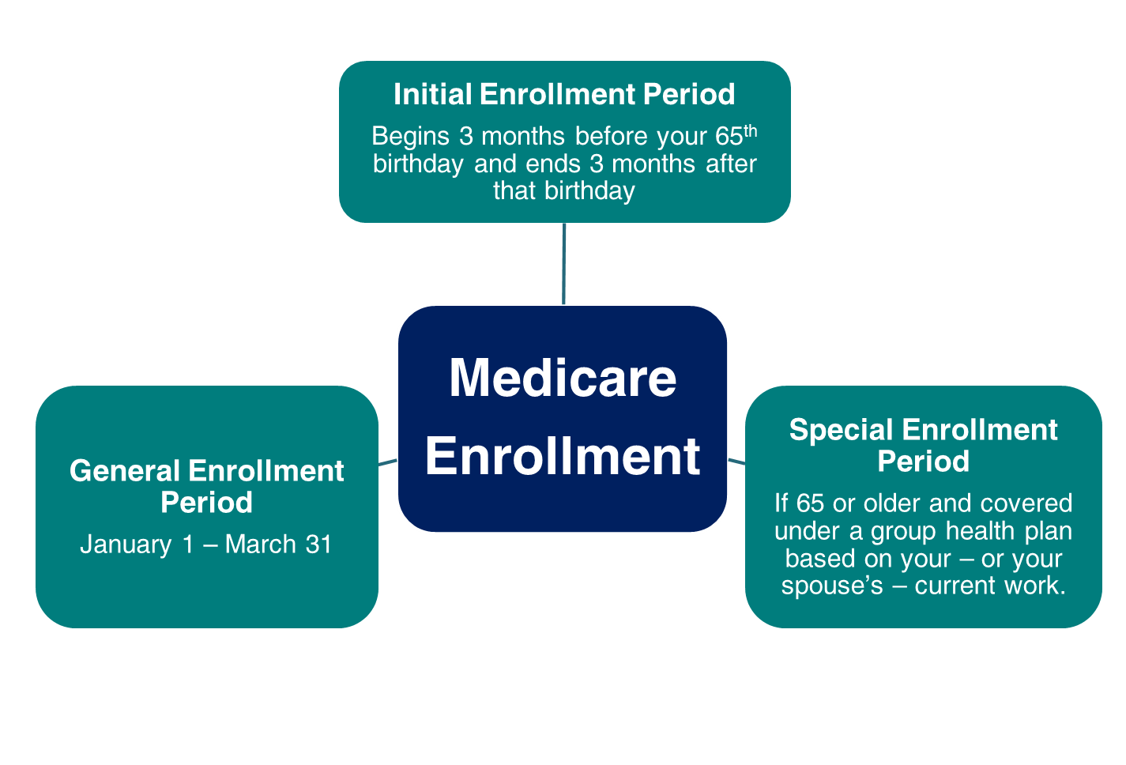
Medicare Enrollment
Notes:
Medicare has three enrollment periods:
Initial Enrollment Period – This is a 7-month period that begins three months before your 65th birthday, includes the month you turn age 65, and ends three months after that birthday.
Special Enrollment Period-- If you are age 65 or older, you or your spouse are still working and you are covered under a group health plan based on that current employment, you may not need to apply for Medicare Part B at age 65. You may qualify for a "Special Enrollment Period" (SEP) that will let you sign up for Part B at the time you retire without a penalty for delayed enrollment.
General Enrollment Period - If you didn't sign up for Part A and/or Part B when you were first eligible, and you aren’t eligible for a Special Enrollment Period, you can sign up during the General Enrollment Period between January 1–March 31 each year. Beginning 2023, coverage begins the month after you enroll. You may have to pay a late enrollment penalty for as long as you have Part B coverage.
You can file for Medicare if you are delaying cash benefits.
Health Savings Account (HSA) Information: You should not contribute to an HSA if you are enrolled in Medicare as there may be negative tax implications.
Note to Speaker: If a person states they missed an enrollment period due to an exceptional condition that prevented them from enrolling, state they can contact SSA to see if they qualify for a Special Enrollment Period due to Exceptional Conditions.
Speaker notes updated OISP/OEEMP 10/13/2022 (SY/JP)
Speaker notes updated 12/6/2022 (SY/JP)

Slide 24
Medicare
Original Medicare | Medicare Advantage (aka Part C)
Part A (Hospital Insurance) Part B (Medical Insurance) | Part A (Hospital Insurance) Part B (Medical Insurance)
You can add: Part D (Prescription Drug Plan) | Most plans include: Part D (Prescription Drug Plan) Extra Benefits (e.g. vision, hearing, dental, and more)
You can also add: Supplemental insurance coverage (Medigap) | Some plans also include: Lower out-of-pocket costs
Medicare.gov
Notes:
Medicare is our country’s health insurance program for people age 65 or older. People younger than age 65 with certain disabilities, or permanent kidney failure, or amyotrophic lateral sclerosis (Lou Gehrig’s disease), can also qualify for Medicare. You have choices for how you get Medicare coverage – Original Medicare and Medicare Advantage.
Original Medicare includes Hospital (Part A) and Medical (Part B) insurance. If you want drug coverage, you can add a separate drug plan (Part D). You can also add a Medicare Supplement Insurance (Medigap) policy to help pay your out-of-pocket costs.
A Medicare Advantage Plan is an all-in-one alternative to Original Medicare. These "bundled" plans include Part A, Part B, and usually Part D. Most plans offer extra benefits— like vision, hearing, dental, and more.
==============
Medicare has 4 parts:
1. Part A is Hospital Insurance which covers most inpatient hospital expenses. The 2022 deductible for Part A is $1,556.
2. Part B is Medical Insurance which covers 80% of doctor bills & other outpatient medical expenses after your first $233 in approved charges. The 2022 standard monthly premium is $170.10. There is no monthly premium for Part A if you are insured for retirement benefits. After you retire, your health insurance may require for Medicare to pay first. Many supplemental plans require you to sign up for Medicare Part B. The Medicare premium most beneficiaries pay represents 1/4 of the actual cost, and the Federal government covers the balance of the cost.
3. Medicare Advantage—also known as Part C— is an “all in one” alternative to Original Medicare. These “bundled” plans include Part A, Part B, and usually Part D. These plans may also have lower out-of-pocket costs and may offer extra benefits that Original Medicare doesn’t cover— like vision, dental, and more.
4. Part D is Medicare Prescription Drug coverage, which covers a major portion of your prescription drug costs. Your out-of-pocket costs—monthly premiums, annual deductible and prescription co-payments—will vary by plan. You enroll with a Medicare-approved prescription drug provider, not by contacting Social Security. Each Medicare Advantage plan can charge different out-of-pocket costs, but they must follow rules established by Medicare. Medicare-approved prescription drug plans cover a major portion of your prescription drug costs.
Learn more with our publication, Medicare, 05-10043. To learn more about Original Medicare, Medigap, or Medicare Advantage plans, visit medicare.gov/Publications/ to view CMS’ publication Choosing a Medigap Policy, Publication 02110, and Understanding Medicare Advantage Plans, Publication 12026.
Slide updated OISP/OEEMP 12/1/2021 (JP)

Slide 25
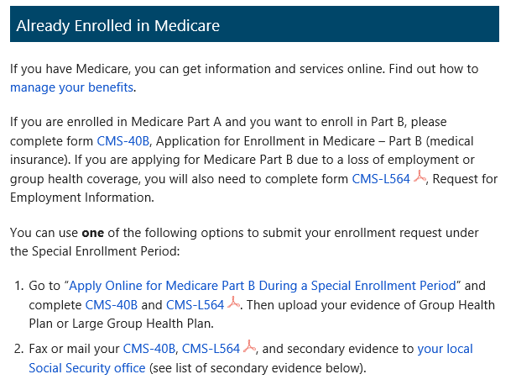
Medicare Applications
If you already have Medicare Part A and wish to add Medicare Part B, complete the online application, or fax or mail completed forms CMS-40B and CMS-L564 to your local Social Security office.
ssa.gov/benefits/medicare
Notes:
You can use our website to apply for Medicare Parts A and B along with Social Security retirement benefits. Most people apply for Medicare Part A along with their retirement benefits because you are required to enroll for Medicare Part A at the same time you start retirement benefits. (Medicare Part A has no monthly premium for those who have 40 work credits.) If you apply online for Medicare Part A only – and refuse Part B (which does have a monthly premium) – you can enroll in Part B later anytime you are still covered by your employer’s GHP or within 8 months after your coverage or employment ends, or during the General Enrollment Period (GEP), Jan-March of the current year. Your Part B coverage starts the first day of the month after you sign up.
If you don’t enroll in Medicare Part B during your initial enrollment period, you have another chance each year to sign up during a “general enrollment period” from January 1 through March 31. Your coverage begins the month after you enroll. Read our Medicare publication for more information – ssa.gov/pubs/EN-05-10043.pdf
If you are already enrolled in Medicare Part A and later you want to add Part B under the Special Enrollment Period, you have three options. You can visit ssa.gov/Medicare-PartB-SEP to complete the online application. You can also fax your completed CMS-40B, Application for Enrollment in Medicare – Part B (Medical Insurance) and CMS-L564 (Request for Employment Information), and proofs to your local Social Security office. Refer to HI 00805.295 Evidence of GHP or LGHP Coverage Based on Current Employment Status for secondary proofs if the CMS-L564 cannot be provided. Lastly, you can also mail your completed forms to your local Social Security office. The two forms are available on our homepage. Just click on the Forms button at the bottom of the page.
Field Office Locator: secure.ssa.gov/ICON/main.jsp
Speaker notes updated OISP/OEEMP 10/13/2022 (SY/JP)
Speaker notes updated 12/6/2022 (SY/JP)

Slide 26
Medicare Standard Part B Premiums for 2023
If you’re single and file an individual tax return, or married and file a joint tax return:
Modified Adjusted Gross Income (MAGI) | Part B monthly premium amount | Prescription drug plan monthly premium amount
Individuals with a MAGI of $97,000 or less Married couples with a MAGI of $194,000 or less | 2023 standard premium = $164.90 | Your plan premium + $0
Individuals with a MAGI above $97,000 up to $123,000 Married couples with a MAGI above $194,000 up to $246,000 | Standard premium + $65.90 | Your plan premium + $12.20
Individuals with a MAGI above $123,000 up to $153,000 Married couples with a MAGI above $246,000 up to $306,000 | Standard premium + $164.80 | Your plan premium + $31.50
Individuals with a MAGI above $153,000 up to $183,000 Married couples with a MAGI above $306,000 up to $366,000 | Standard premium + $263.70 | Your plan premium + $50.70
Individuals with a MAGI above $183,000 up to $500,000 Married couples with a MAGI above $366,000 up to $750,000 | Standard premium + $362.60 | Your plan premium + $70.00
Individuals with a MAGI equal to or greater than $500,000 Married couples with a MAGI equal to or greater than $750,000 | Standard premium + $395.60 | Your plan premium + $76.40
Notes:
This graphic shows the Medicare premiums for each income bracket.
Most Medicare beneficiaries pay the standard premium for Part B - $164.90/month in 2023. It is automatically deducted from their Social Security check if they receive one.
If not getting a check, they can be billed or have the premium deducted from a checking or savings account.
People with higher incomes will pay more for Part B and their prescription drug plan premium. This is called IRMAA – Income Related Monthly Adjustment Amount.
We determine whether you pay the higher premium every year.
To decide your IRMAA, we ask the IRS for your Modified Adjusted Gross Income (MAGI). That equals your adjusted gross income + certain tax-exempt income from the federal income tax return you filed two years ago.
For example, your 2023 Part B premium is determined by your MAGI on your 2021 return. If your 2021 tax return is not available, we will use your 2020 tax return.
Health Savings Account (HSA) Information: You should not contribute to an HSA if you are enrolled in Medicare as there may be negative tax implications. Contact your tax professional for more information.
=====
[SPEAKER: see chart at bottom of this page>> medicare.gov/part-d/costs/premiums/drug-plan-premiums.html for Part D information]
IRMAA resource: https://secure.ssa.gov/poms.nsf/lnx/0601101035
Updated: OISP/OEEMP 10/13/2022 (SY/JP)

Slide 27
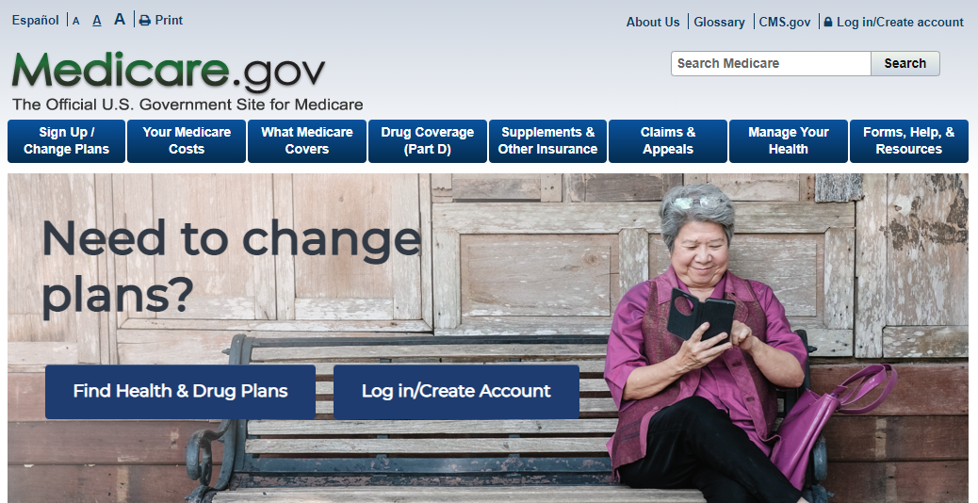
Medicare.gov
1-800-MEDICARE or Medicare.gov
Notes:
Please keep in mind that although you apply for Medicare by contacting Social Security, and we have some Medicare information on our website, it is actually another federal government agency, Centers for Medicare & Medicaid Services, commonly referred to as “CMS” that administers the program. CMS is your main source for information regarding Medicare.
Social Security helps you apply for Medicare Parts A and B, and we send your entitlement information electronically to CMS.
We can also take your application for Extra Help with Medicare Part D.
If you sign up for Part B, we deduct the premium from your monthly Social Security benefit – and send it to CMS – before you receive your payment from us each month.
If you enroll in Medicare only, CMS will bill you for your Part B premiums until you go on Social Security.
If you have any questions regarding the Medicare program, you can call CMS at 1-800-MEDICARE or visit Medicare.gov
Your State Health Insurance Assistance Program (SHIP) can help answer any Medicare questions you may have. To get the phone number for your local SHIP office, visit shiphelp.org or look in your “Medicare & You” handbook. For more information about Medicare, please visit Medicare.gov or call 1-800-MEDICARE (1-800-633-4227). TTY users can call 1-877-486-2048.
Speaker notes updated: OISP/OEEMP – 10/13/2022 (SY/JP)

Slide 28
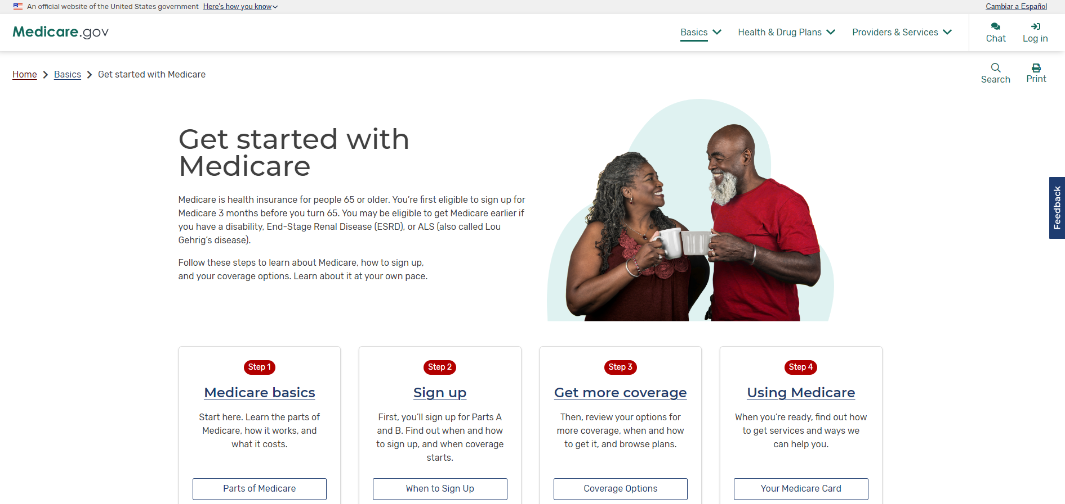
Medicare.gov
Create an account at Medicare.gov
Notes:
Medicare has a free, secure online service for accessing personalized information about your Medicare benefits and services with a Medicare.gov account. It is available at Medicare.gov.
After you create an account, you can fill out the Initial Enrollment Questionnaire (IEQ), view claims information, get quality information about your providers, and more.
For more information or help with the site, please contact the Centers for Medicare & Medicaid Services at 800-MEDICARE (800-633-4227).
Screenshot updated 10/13/2022 (SY/JP)

Slide 29
Extra Help with Medicare Prescription Drug Plan Costs
Medicare beneficiaries may qualify for Extra Help with Medicare prescription drug plan costs
Needs-based program for people with limited income and resources
Extra Help may be worth an estimated $5,000 per year
ssa.gov/extrahelp
Notes:
Extra Help is available for beneficiaries with limited resources and income to help pay for the costs related to a Medicare prescription drug plan.
These costs include monthly premiums, annual deductibles and prescription co-payments.
Extra Help is estimated to be worth about $5,000 per year.
You may apply for Extra help online, over the phone, or in your local Social Security office.
=====
Source: ^OISP OEEMP, CMS Actuary, SSA Publication: ssa.gov/pubs/EN-05-10508

Slide 30
Follow Us on Social Media!
@SocialSecurity

Slide 31
Q&A session
Notes:
Option for speaker:
You can use this slide OR switch to the visual “Rotating Brand Images” presentation found on the PARC as a scrolling visual while answering questions.

